Slide 1

Time Series Analysis: Forecasting Tesla with ARIMA
Nader LIddawi

Slide 2
Motivation
Knowing with some confidence the future value of a stock price is important for buying and selling decisions
For example, we can use time series forecasting to our advantage to come up with an options trading strategy

Slide 3
Outline
Theory
Plot the Data
Transform the Data
Detrend the Data
Identify the Dependence Orders of the Model
Parameter Estimation
Residual Diagnostics
Model Choice
Stock Forecasting
Back-testing
Propose Spread Strategy

Slide 4
Time Series Theory
Autoregressive Model – AR(p)
Current observation is written as a linear combination of the past observations
The coefficient parameter estimate, phi, is found via Maximum Likelihood Estimation
p order in AR(p) is the number of phi’s in the AR model
And w is the white noise residual term (with mean 0 and constant variance)
Moving Average Model – MA(q)
Current observation is written as a linear combination of past white noise terms
The parameter estimate, theta, is found via MLE which finds the estimators such that the chance of observing the historical residuals is maximized
q in MA(q) is the number of thetas in the MA model
White noise terms are independent and identically distributed (with 0 mean and constant variance)

Slide 5
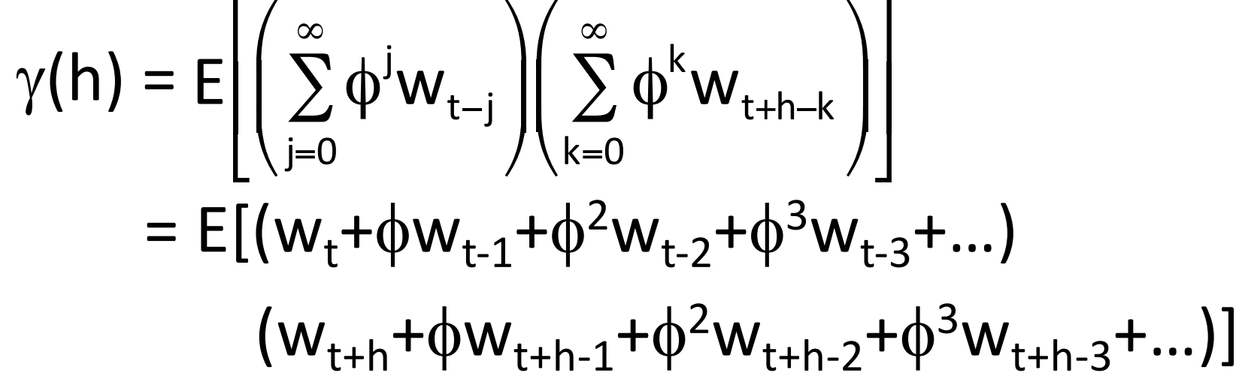
Auto-Covariance
Auto-covariance function describes the relationship of two points
Where h equals the lag or distance from the current data point, auto-covariance for MA can be written like this:
We can then simplify the equation by combining like terms once we have our lag h stipulated
Like terms equal sigma^2 and non-like terms equal 0 since different white noise terms are not correlated
And the auto-covariance of the AR model can be written like this:
Note that AR model can be written as an infinite series of white noises as shown above

Slide 6
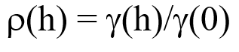
Auto-Correlation Function
Auto-Correlation Function (ACF) is simply the auto-covariance function at lag h divided by the auto-covariance function at lag 0 (i.e., current point)
In fact, p(h) is the length of the bars at each respective lag h when we look later at the ACF and PACF plots
Auto-correlation gives us a more interpretable measure of a point’s relationship with another
The Partial Auto-Correlation Function (PACF) removes the confounding effects of intermediary points between, for example, xt and xt-3, such that xt-1 and xt-2 are not being accounted for
Choose ACF plot to evaluate MA models, and PACF plot to evaluate AR models*
When we plug in the parameter estimates back into the ACF and PACF, we get correlation constants that describe the relationship between a data point and the current point (i.e., bars on the plots)
*Evaluating the opposite way will not reveal significant correlation relationships

Slide 7
Stationarity
A stationary time series is a sequence of data ordered by time but whose probability distribution does not vary or change with respect to time
For time series forecasting to work, data points must only be distinguished solely by their distance from one another, and not on where in particular the data points lie on the timeline
So, a stationary data set must have:
Constant mean
Constant variance
No trend (i.e., zero drift)
Non-correlated white noise terms, with 0 mean and constant variance
No seasonal spikes

Slide 8
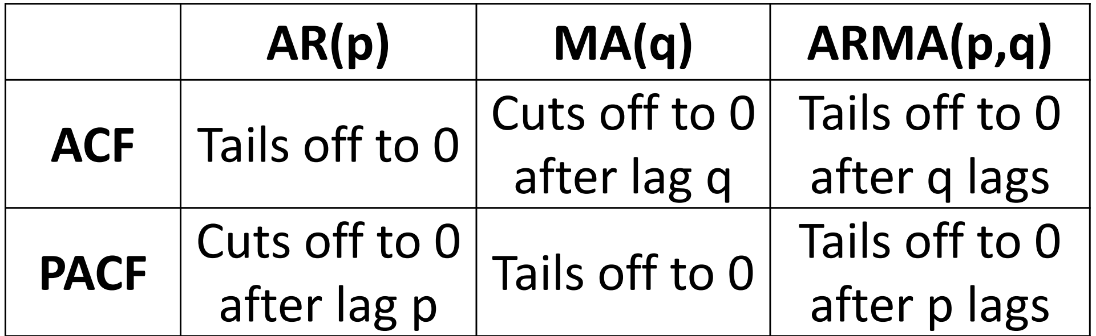
ARIMA: The Combined Model
Combining the AR and MA models can help us in forecasting future values given both past observations and their error terms
This combined model, which may have greater explanatory power, is called the ARMA model
Adding differencing, which eliminates the trend in data, gives us the ARIMA model, with which we will use to forecast Tesla stock price
Note that the table above shows why ACF is used for MA models and PACF is used for AR models. A correlation bar “cutting off” can indicate which p, q lag order to use in our AR(p), MA(q) or ARMA(p, q) models

Slide 9
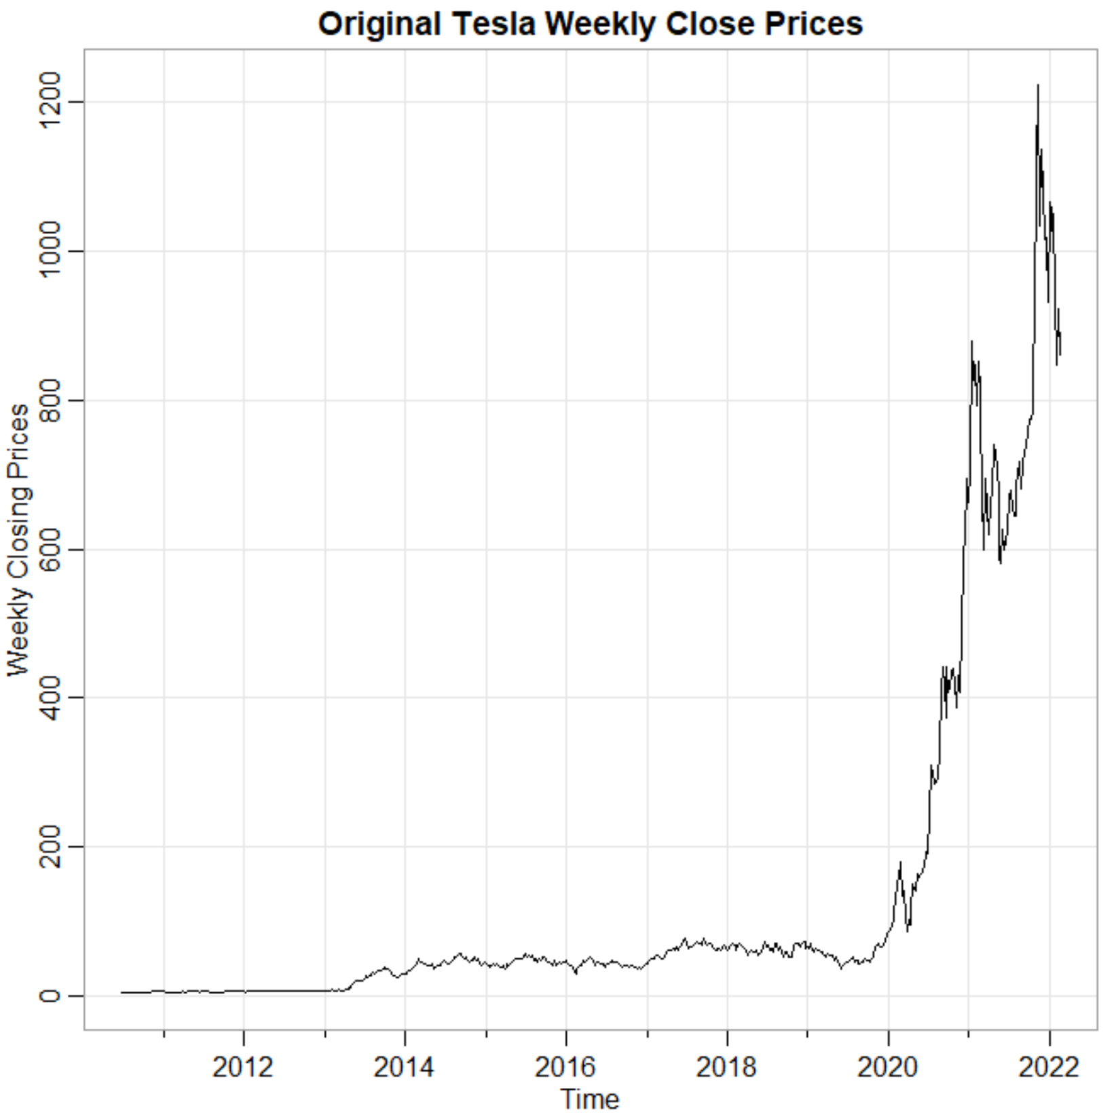
Plot the Data
Our weekly data represents the closing prices since Tesla’s stock market debut in July 2010 thru Feb. 11, 2022
Volatility from 2010 thru 2013 looks the same but appears to increase from 2014 thru 2018. And from 2019 thru 2022, we see a huge increase in volatility. So, volatility of Tesla is not constant with time

Slide 10
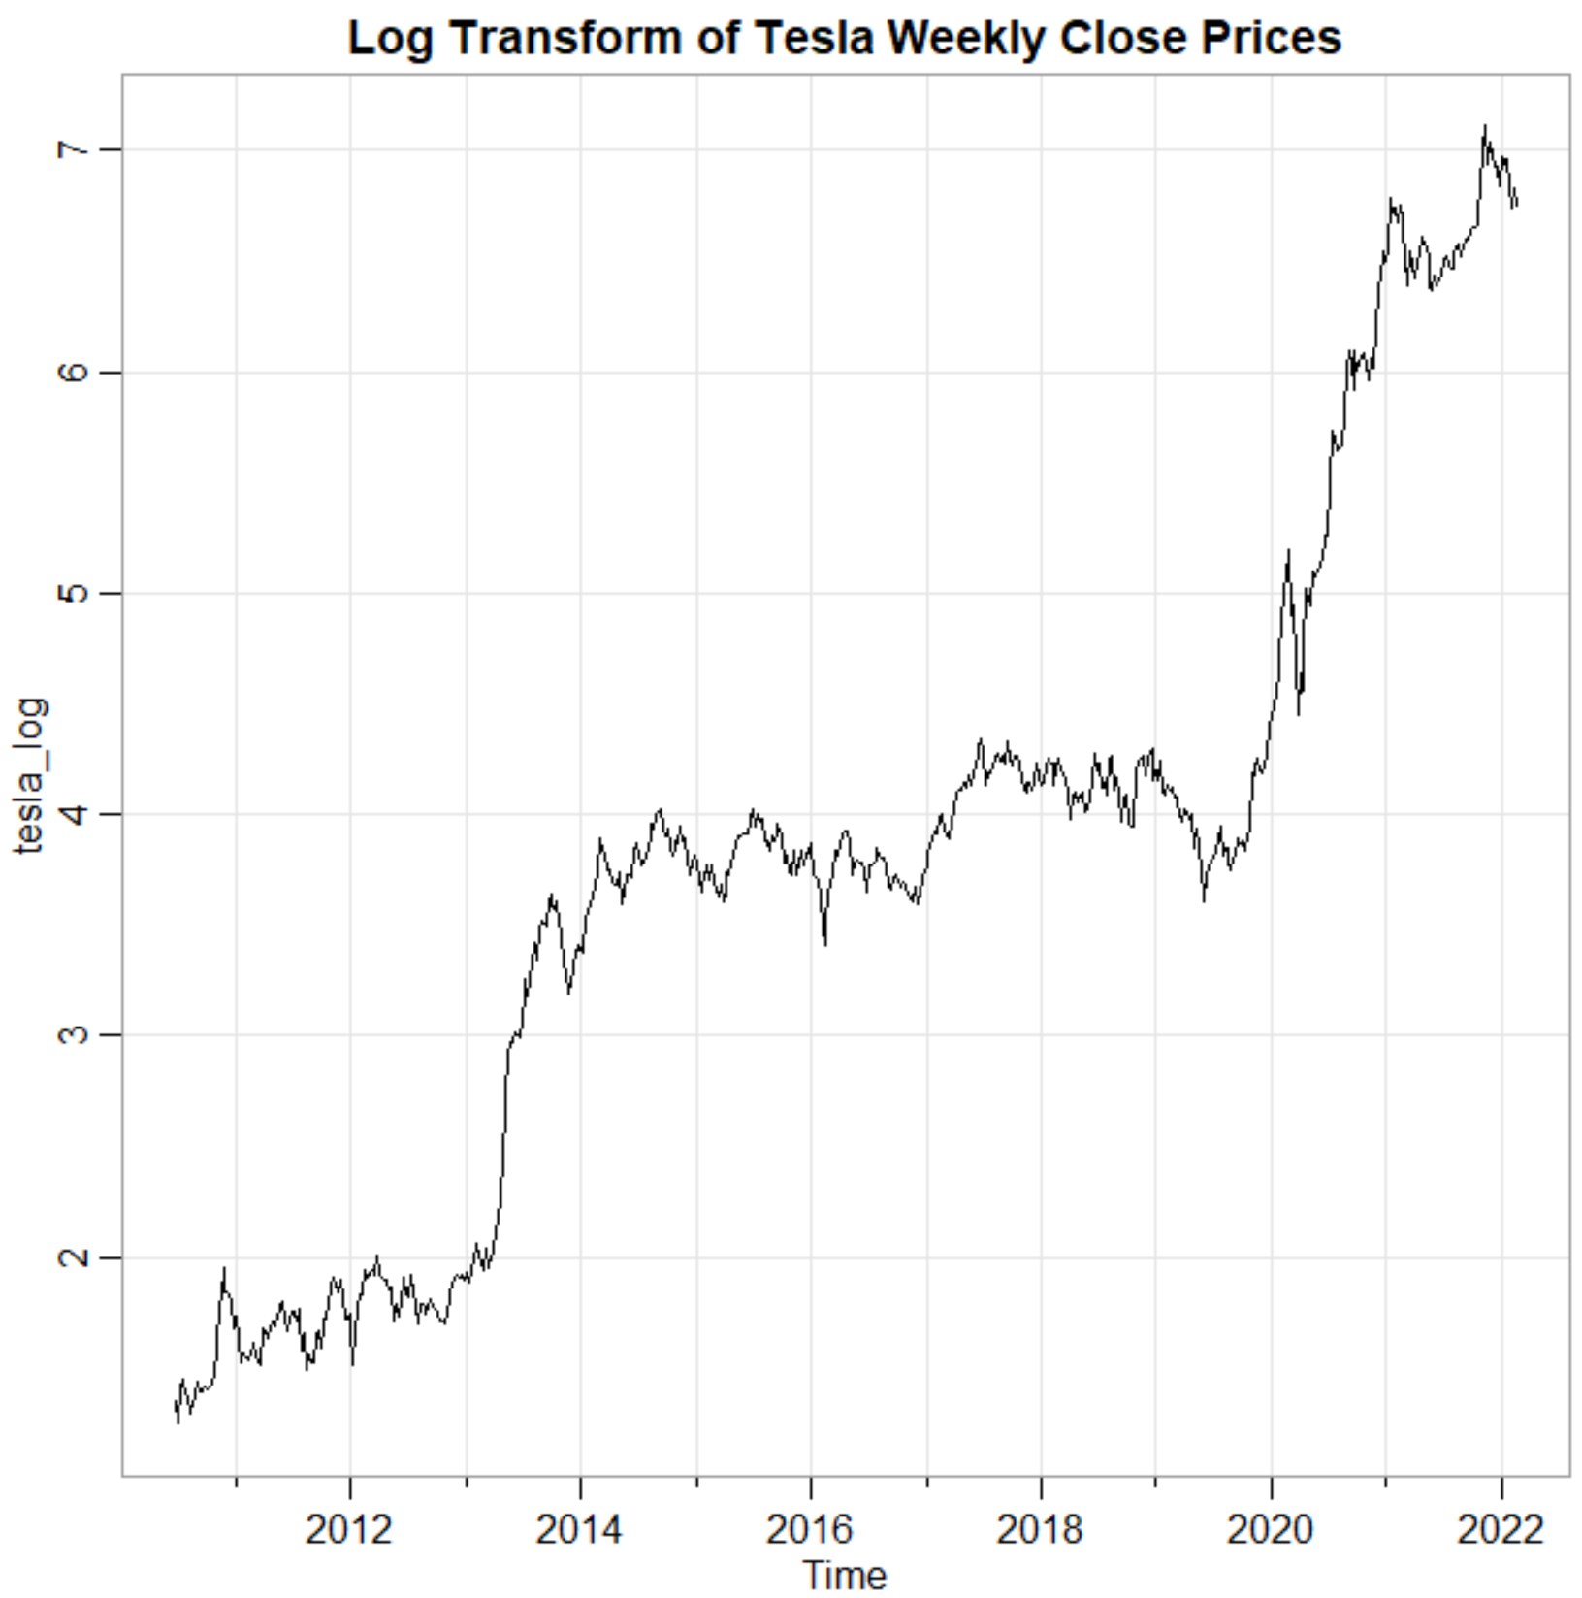
Transform the Data
To achieve good predictive power in forecasting future prices, we must ensure that the data has uniform variance
That is, we need to log transform the data such that this normalization technique can bring the data to constant variance with respect to time
Even after transformation, we do still see that 2019-2022 period have higher variance than the rest of the data set
However, the logarithm did clean up the data decently

Slide 11
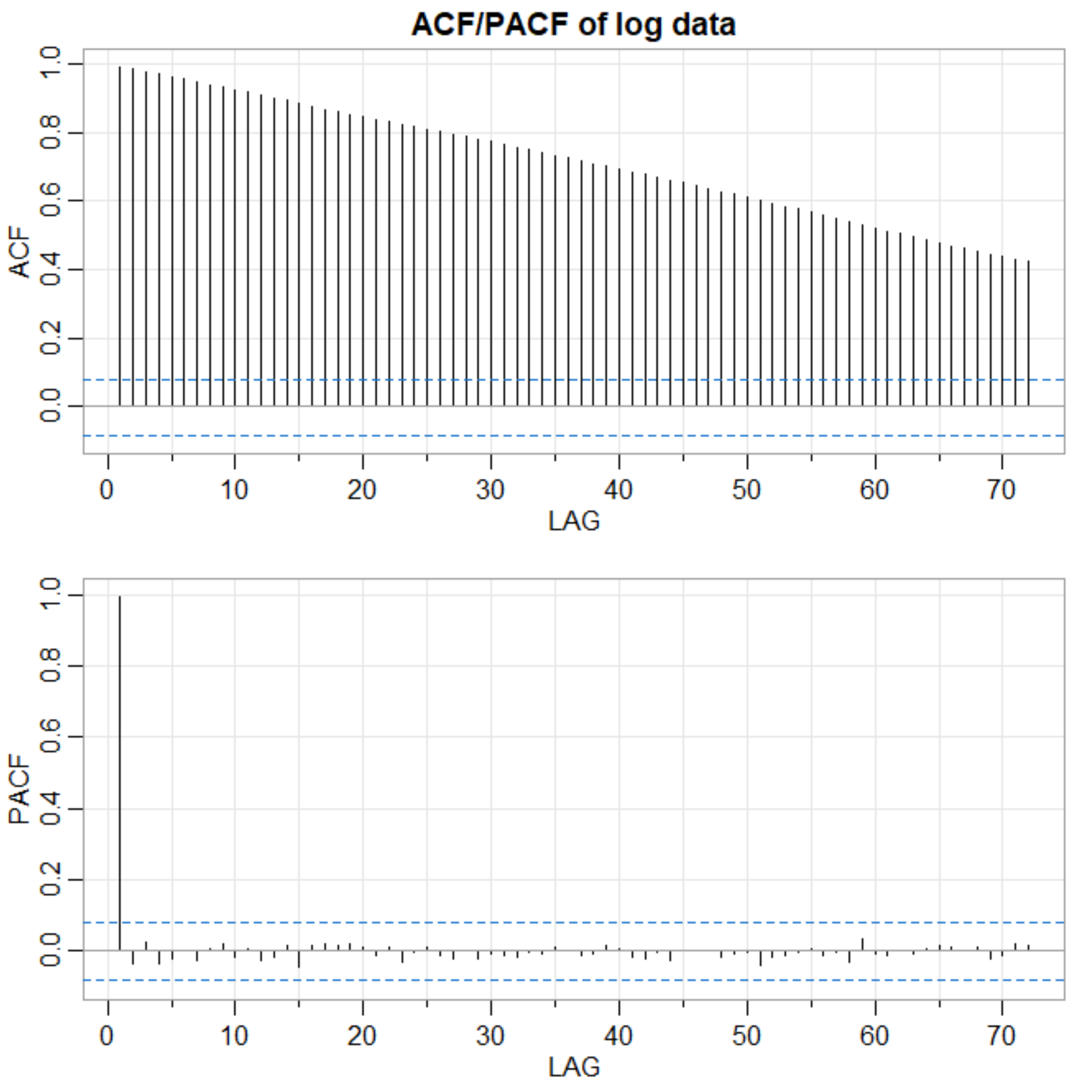
Non-Stationary Data
Our log data is also non-stationary since the residual terms are correlated, as shown in the ACF plot
The slowly decreasing sequence of bars need to be eliminated to satisfy stationarity
And we can eliminate this correlation via the simple Differencing method
Note: No seasonal, periodic spikes exist in the plots

Slide 12
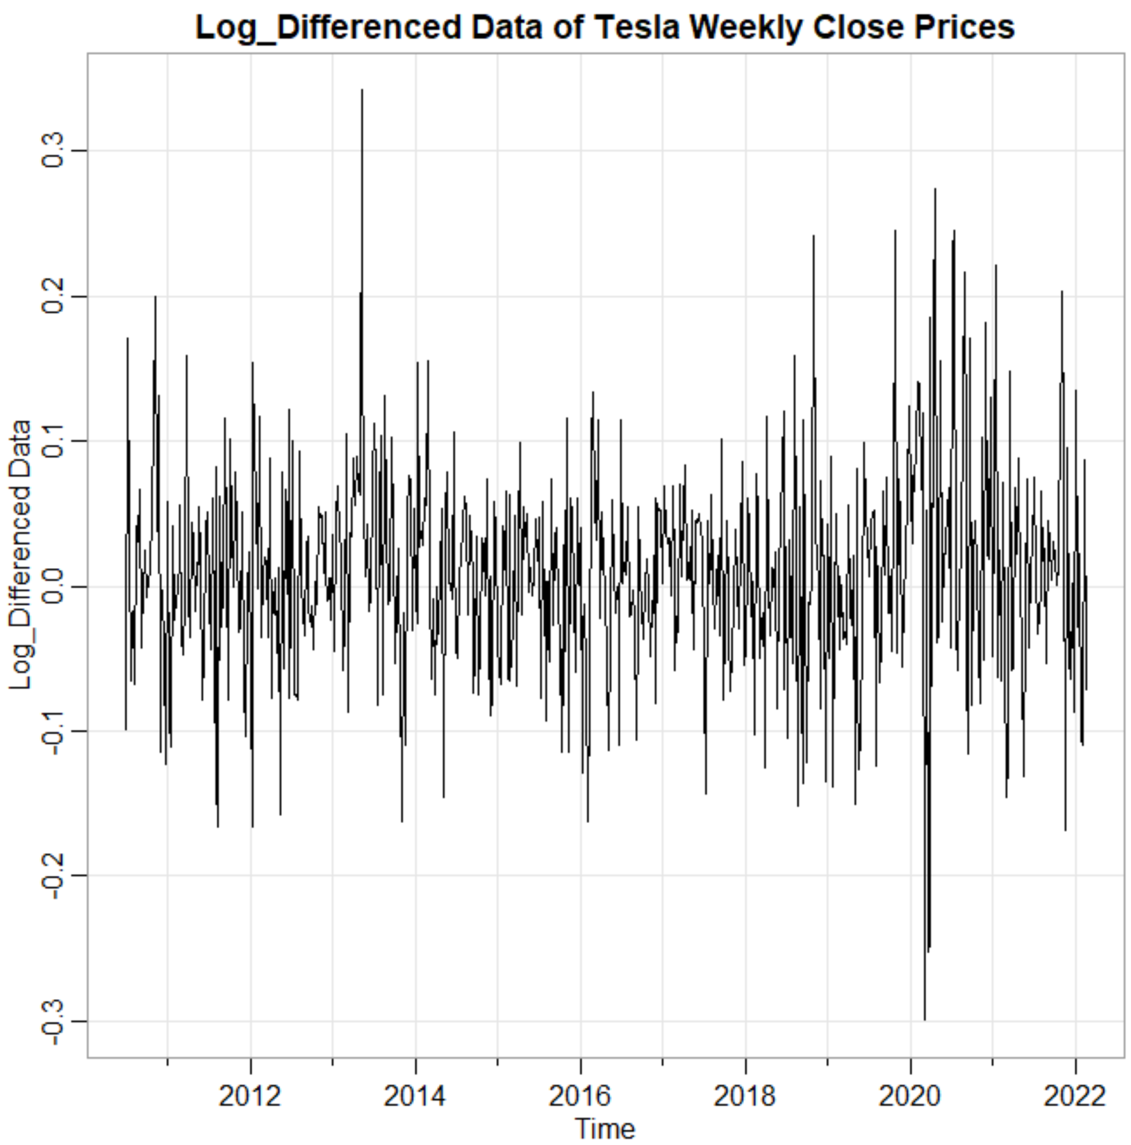
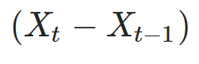
Detrend the Data: Differencing
In order to attain stationarity, we need to eliminate the trend in the price with respect to time
So, we can take the difference of every neighboring two data points, like between x2 and x1
(Xt - Xt-1) can get us to a constant mean, which means no trend and no drift

Slide 13
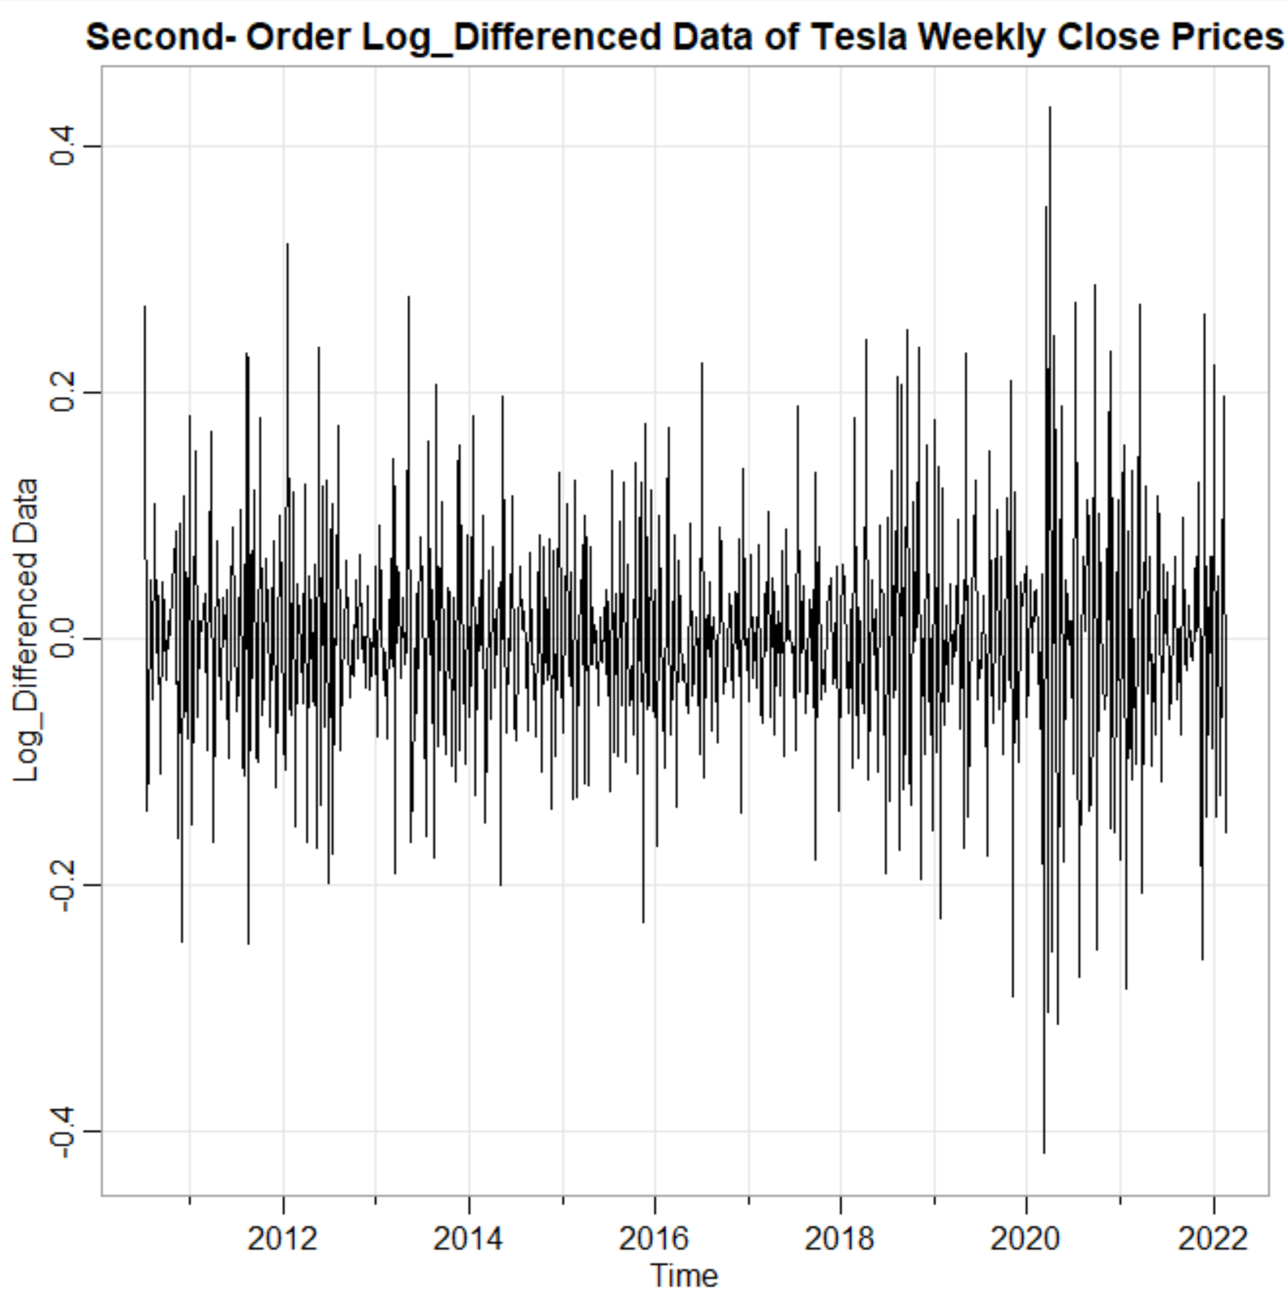
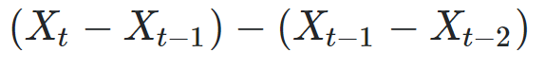
Second-Order Differencing
Take the second-order differencing to eliminate the residual trend in the first-order- differenced data
The second-order differencing is simply the difference of the first-order-differenced data
The plot now becomes more jagged, with sharper movements to the upside and downside

Slide 14
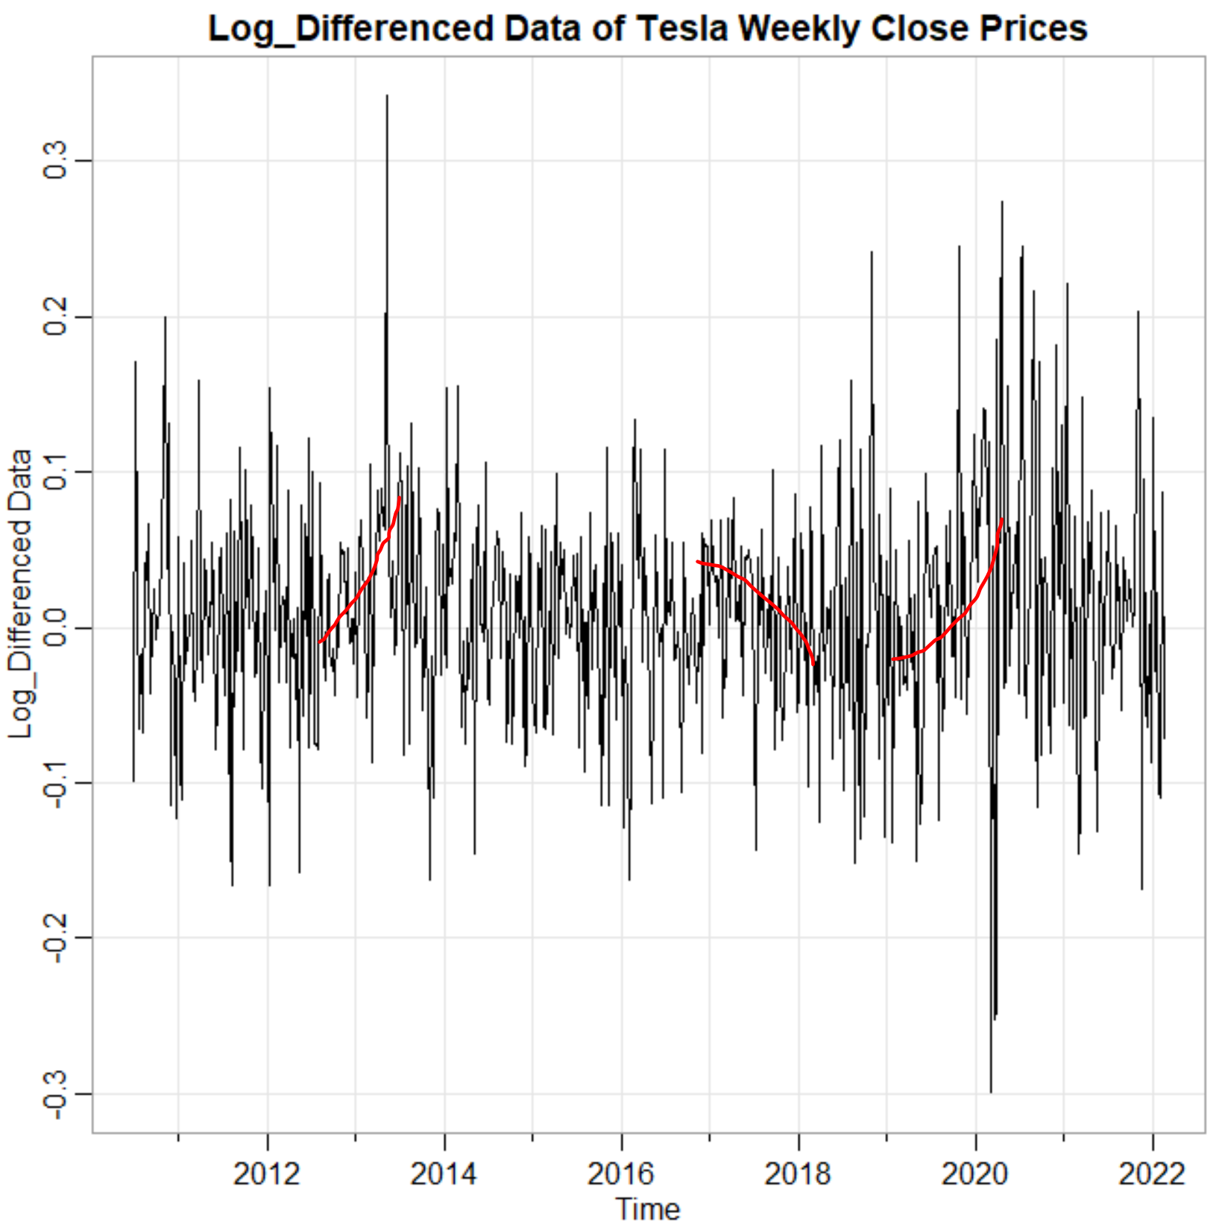
Compare 1st order & 2nd order Differencing
Trend continues to exist
Lingering trend eliminated

Slide 15
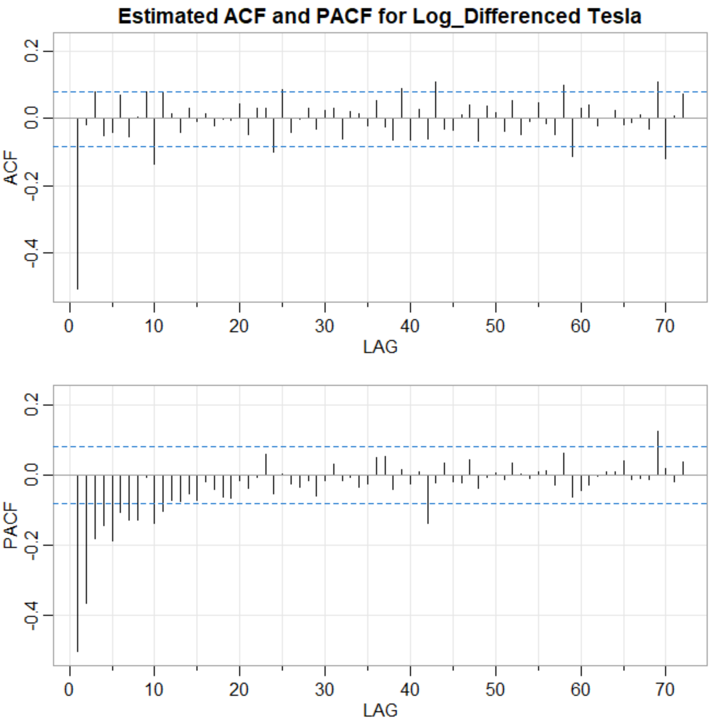
Plot the ACF and PACF
The ACF plot will guide us on what order MA term will be
We can say that MA order is 1 since bar at lag 1 falls outside of insignificance bounds
The PACF plot will guide us on what order AR term will be
We can say that the AR order is 3 since the bar at lag 3 falls outside of the insignificance bounds. We could also have chosen AR order of 10 or 69 but we want parsimonious model

Slide 16
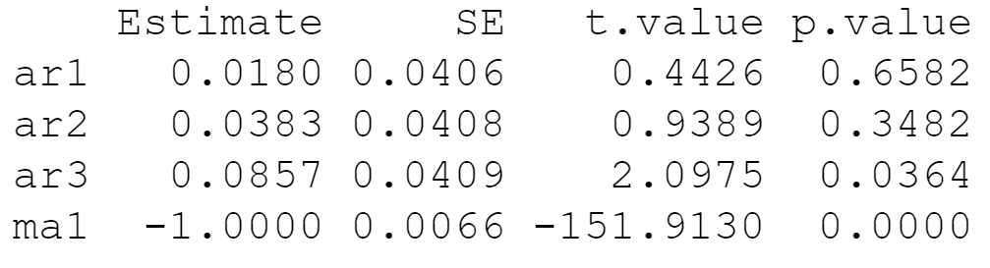
Parameter Estimation
ARIMA(3,2,1) is our candidate model, since 3rd lag in AR and appeared significant, the fact that we used 2nd order differencing and that the 1st lag in MA appeared significant
We can derive the parameter estimates via Maximum Likelihood Estimation in R code
MA parameter is significant to our forecast since p-value < .05, but no AR estimates are significant since p-values > .05
Note: Even though AR(3) has p-value <.05, we cannot just eliminate AR(1) and AR(2) but keep AR(3)

Slide 17
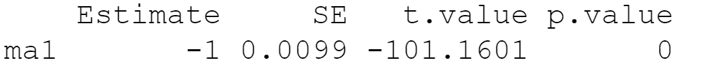
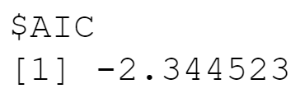
Parameter Estimation: Another Attempt
Let’s try to eliminate the AR terms altogether due to the insignificance of our AR terms in forecasting
It appears that MA(1) order alone is good with p-value<.05
In fact, we tried numerous candidate models with different orders and found ARIMA(0,2,1) to be the only significant model
If we would have found multiple models that satisfy the p-value and residual criteria, then we would have selected the model with the least AIC score, which penalizes for model complexity

Slide 18
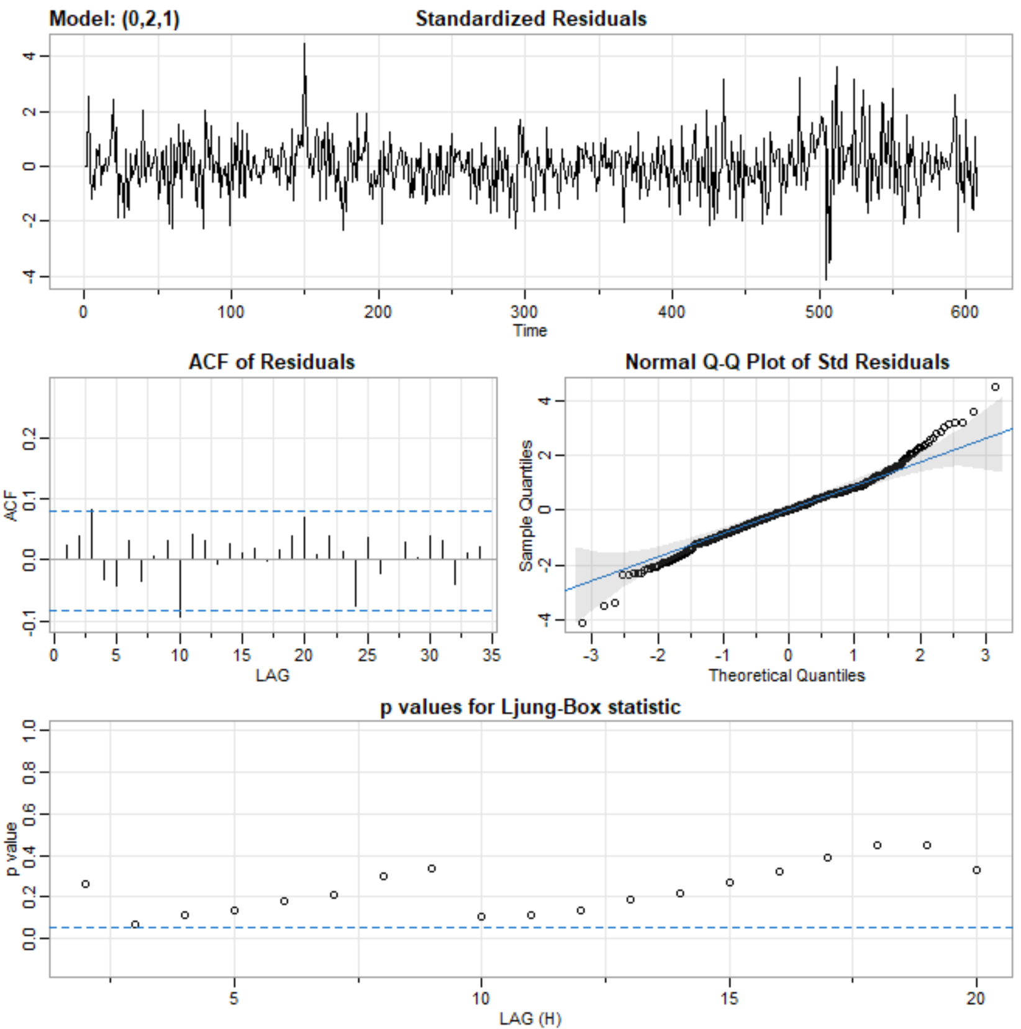
Residual Diagnostics
We want to ensure that time series assumptions about error terms are satisfied: Non-correlation and Normality
Residual non-correlation is satisfied since ACF of Residuals plot has hardly any bars outside the insignificance bounds
Normality is satisfied since the residual points hug the line, more or less, in the Normal Q-Q plot
However, there does exist large and non-constant residual variance in the Standardized Residuals plot, especially at time 150 and ~500
GARCH model can be used in addition to ARIMA to complement and handle for such non-constant variance

Slide 19
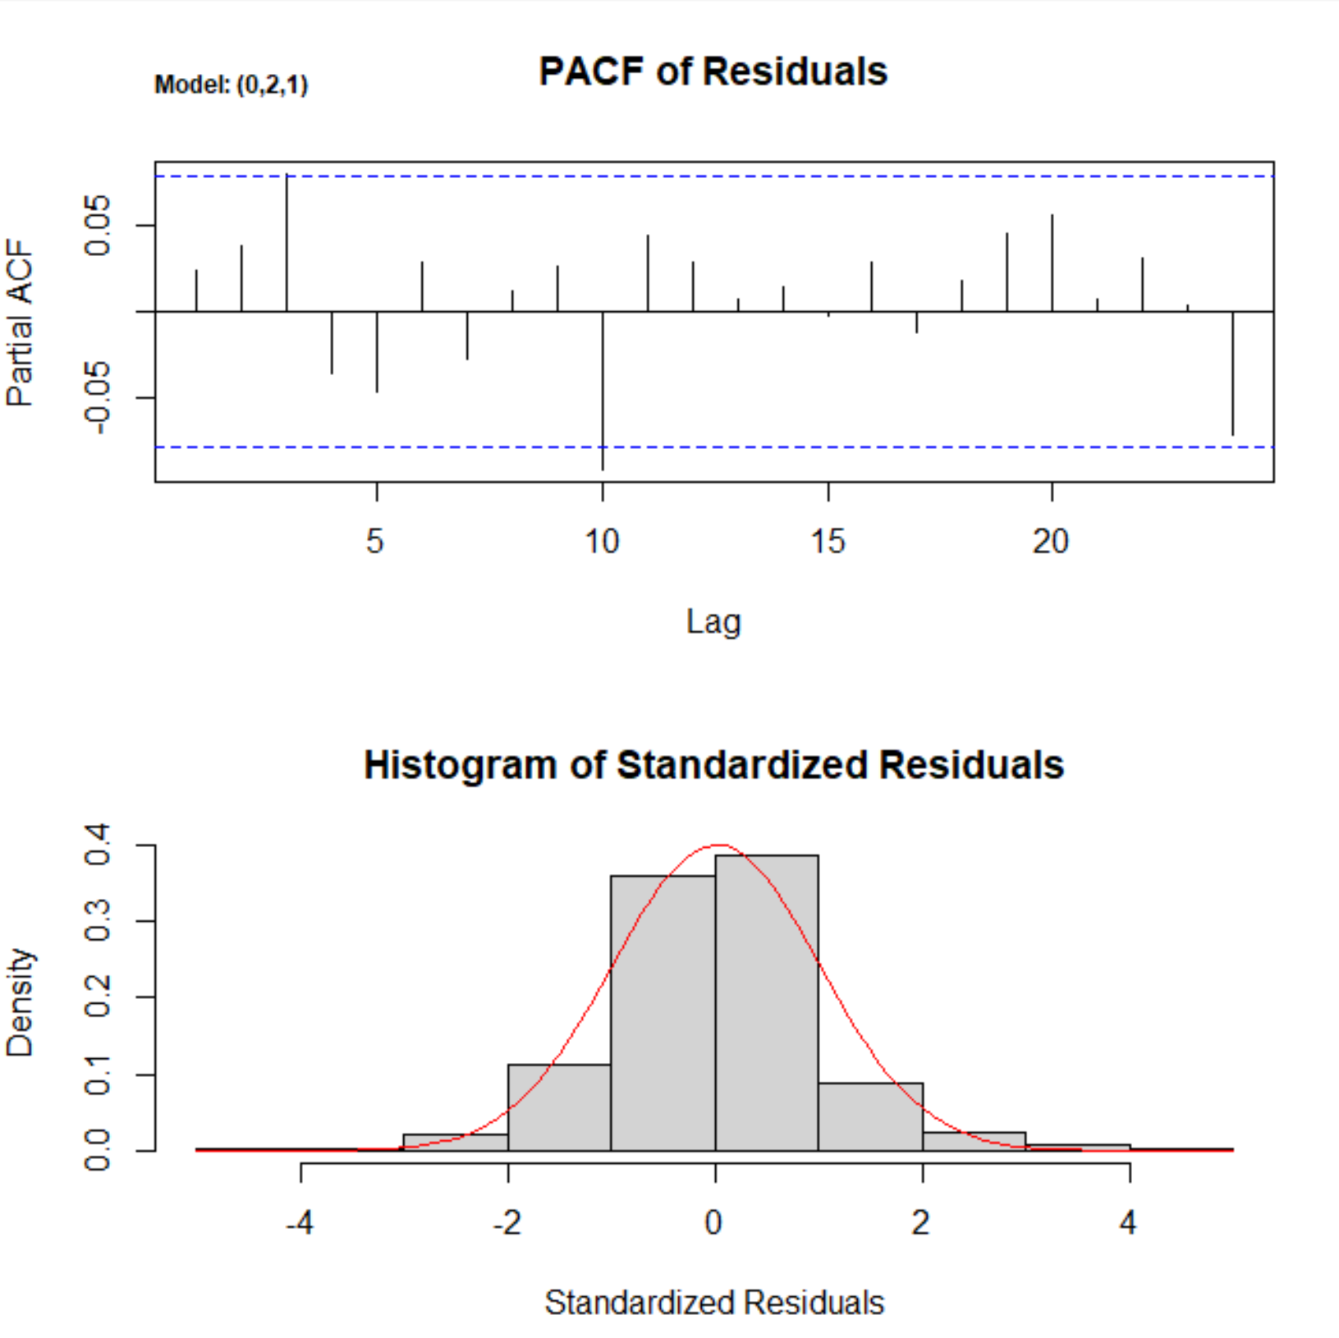
Diagnostics Continued
Moreover, PACF of Residuals plot shows hardly any bars outside insignificance bounds, suggesting little residual correlation
And the Histogram plot forms a bell-shaped curve, suggesting residual normality
Lastly, the Ljung-Box statistic in the previous slide illustrates most points above the significance level. So, we fail to reject the null hypothesis that there exists no residual correlation

Slide 20
Model Choice
We have shown that the ARIMA(0,2,1) model has significant parameter estimates and has no residual assumption violations
We diagnosed the residuals to ensure that no residual pattern exists that can be explained away by some phenomena other than irreducible white noise
We are now ready to forecast our log data using the model parameters we found

Slide 21
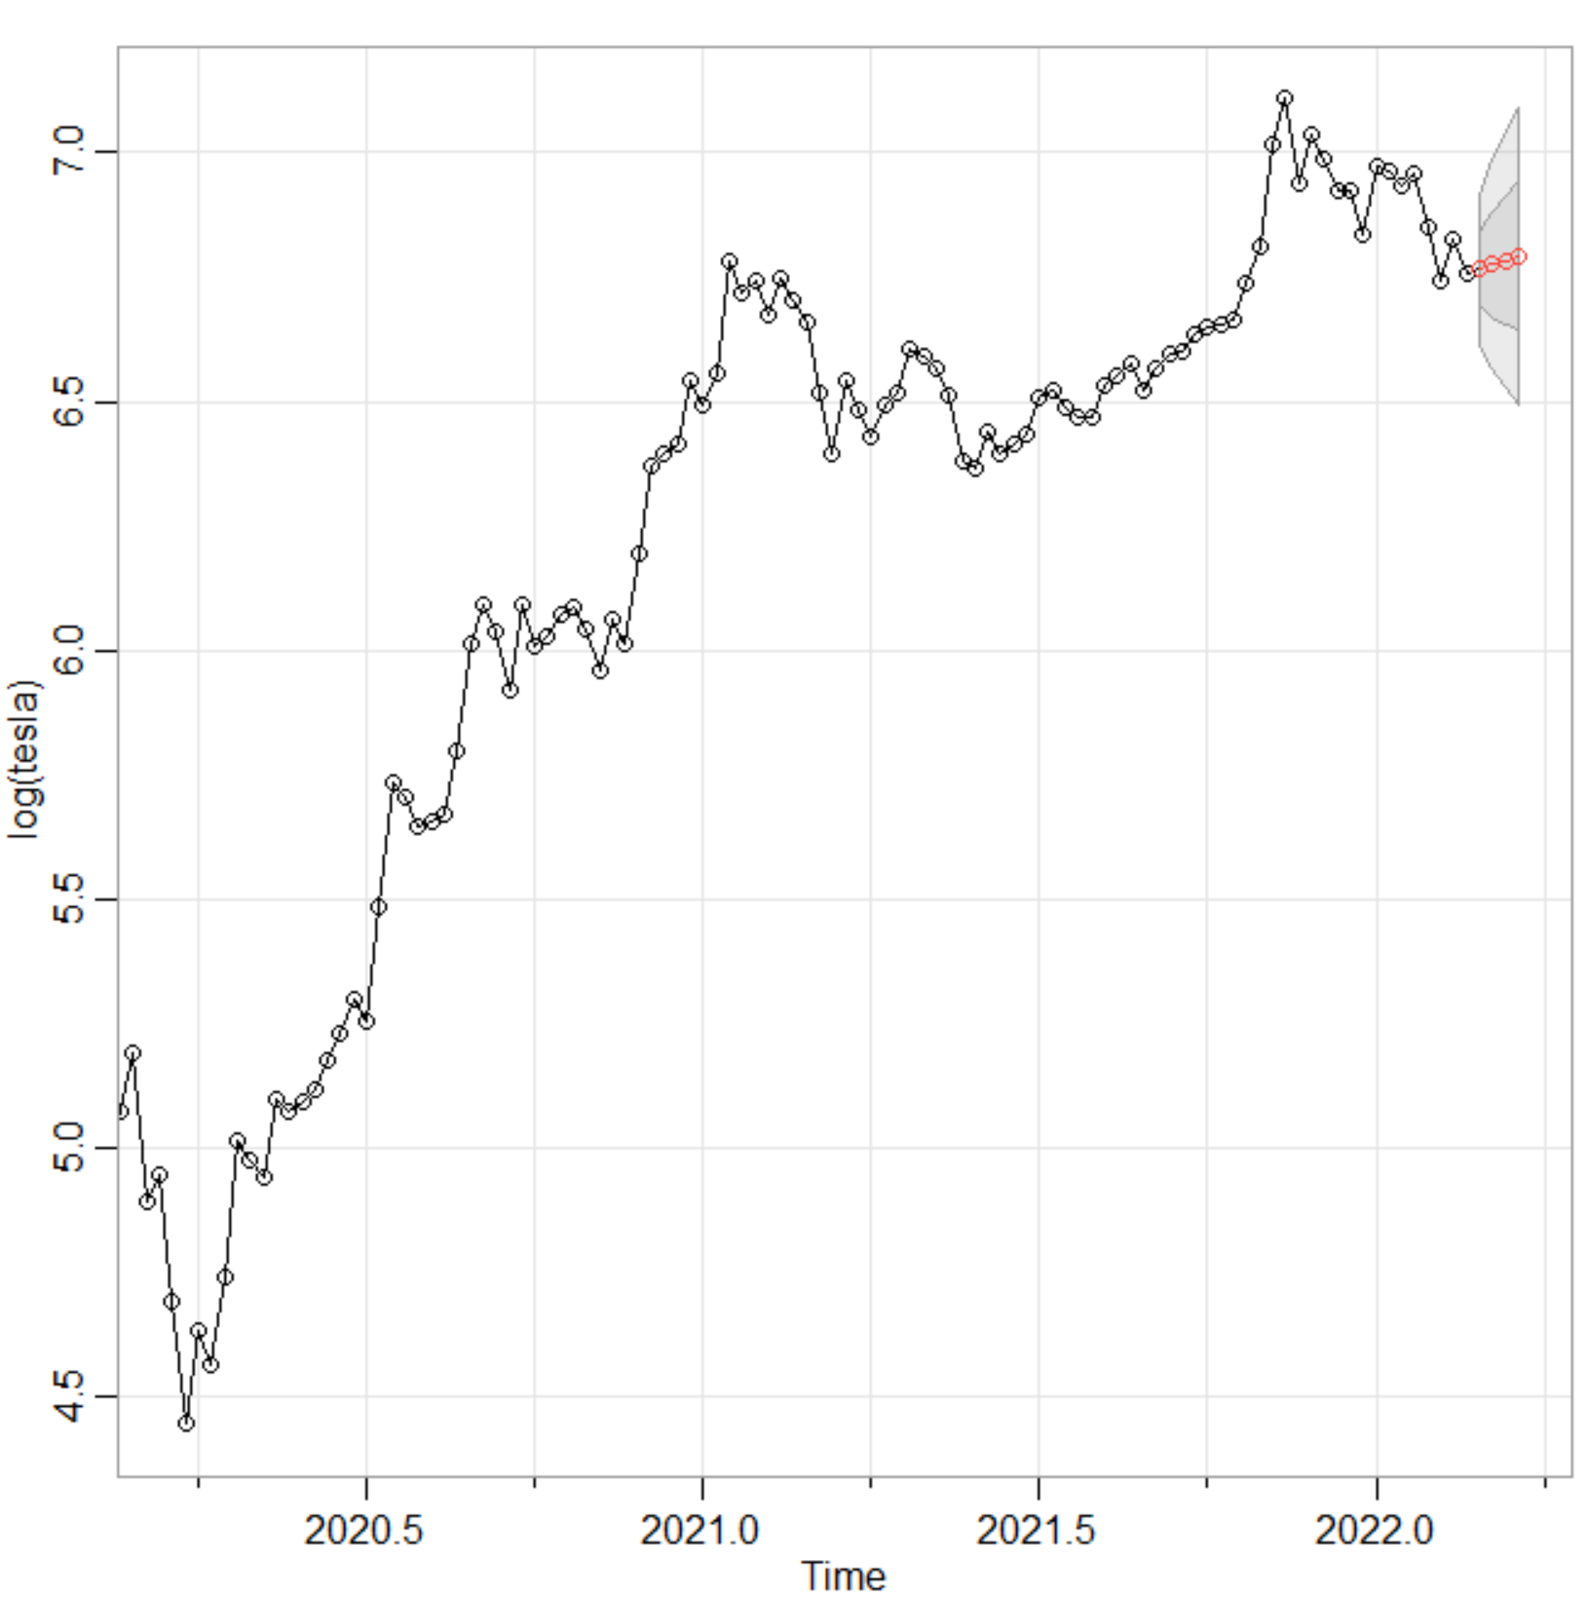
Stock Forecasting
We forecast 4 weeks out the log data of weekly Tesla stock price
The inner, dark band represents the Confidence Interval, where the mean is expected to lie with 95% confidence
And the outer, light band represents the Prediction Interval, where any data point (which is more volatile than the mean) is expected to lie with 95% confidence
Note: only estimate a few periods out since Time Series does not predict as accurately in the far future

Slide 22
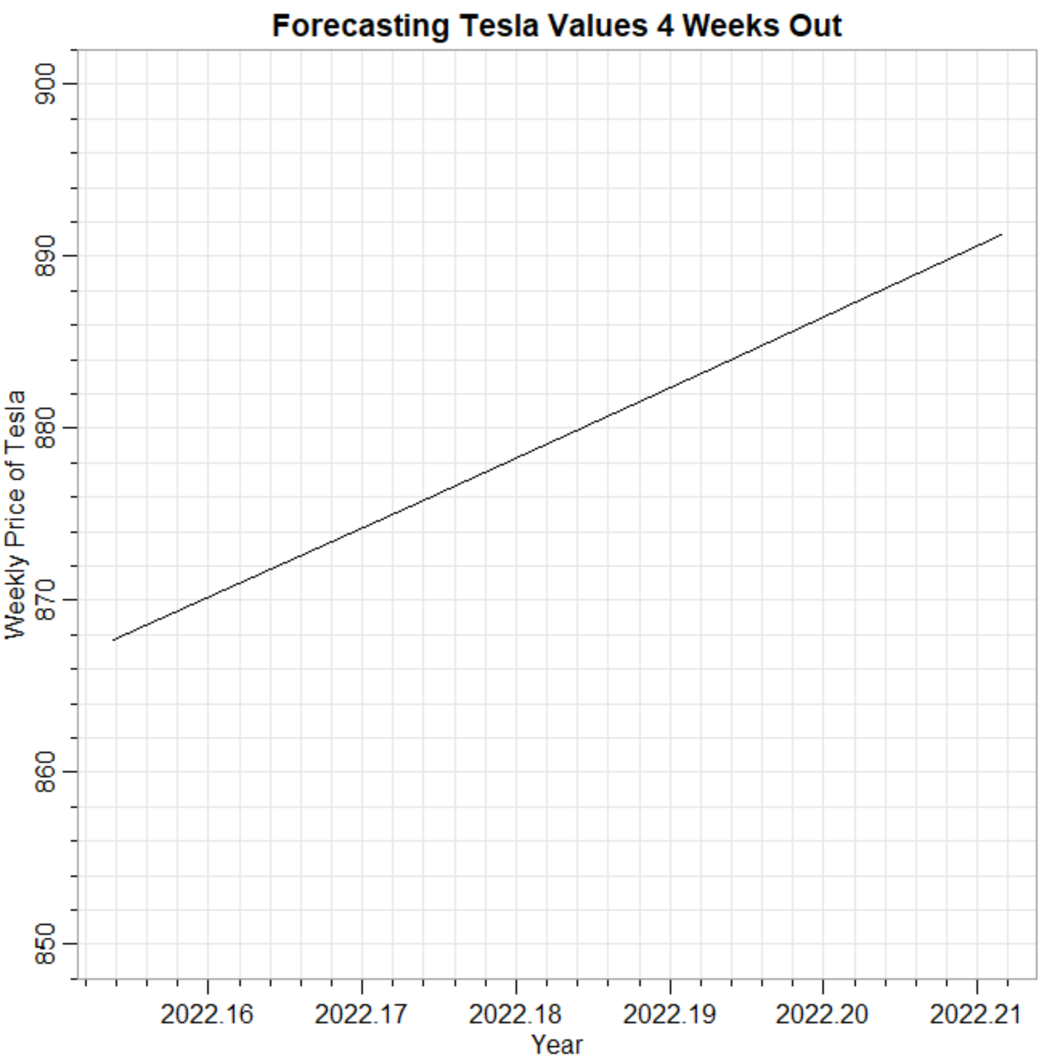
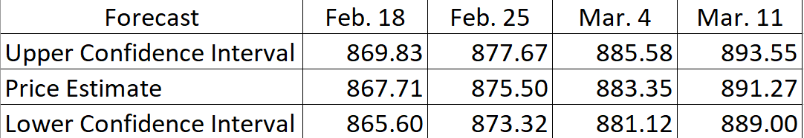
Get Real Prices
We need to transform back the data to get our real, raw weekly price forecast
We can simply take the opposite or inverse of the logarithm: the exponential
Our weekly forecasted prices four weeks into the future from Feb 11, 2022:
Above CI intervals are calculated thusly: estimated value +/- (standard error * z-score)

Slide 23
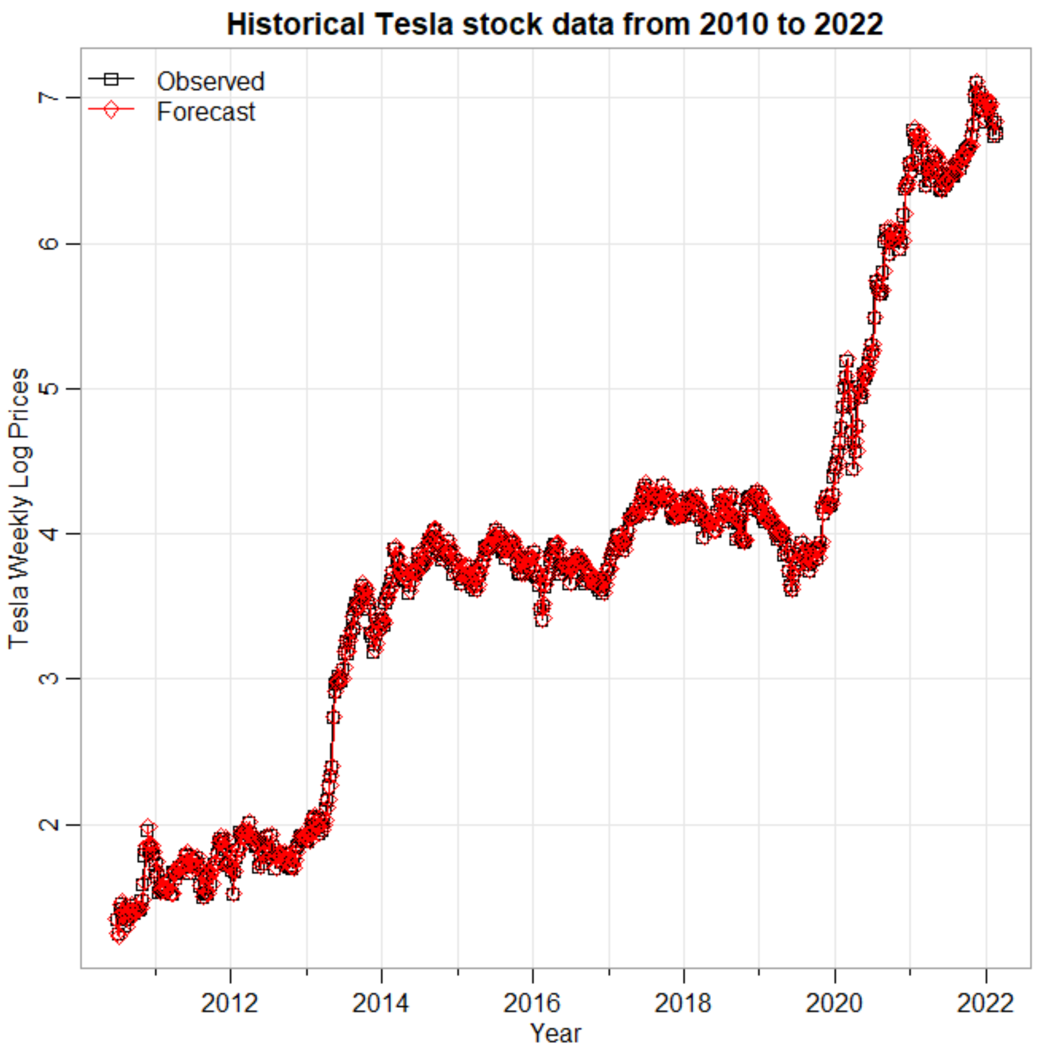
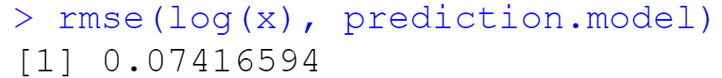
Back-testing
We want to see how well our model would have performed were it to have forecasted our historical observations
This plot shows the error rate of the prediction our model estimates relative to the true historical weekly values of the Tesla stock price
All in all, the model did a pretty good job as the forecast prices are superimposed neatly on the observed prices
Our model’s prediction has a Root Mean Squared Error of 0.07

Slide 24
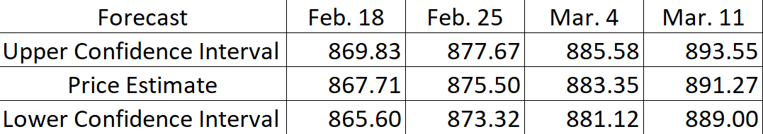
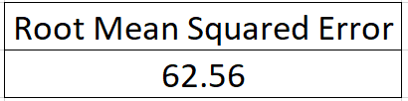
RMSE of Predictions
Even though our back-testing Root Mean Squared Error was only 0.07, our RMSE for future predictions relative to actual prices was larger, at 62.56
The larger RMSE can be owed to the fact that the markets have entered into greater correction territory
However, there have been multiple corrections during our historical data set. So, this leads us to believe that our prediction via back-testing has been over-fit to the data
Note: Feb. 11 was the last data point we used to fit the time series model. Feb. 18 to March 11 was the predicted four-week period. We simply compared the predicted values with the actual, realized values once they became available (i.e., once the future dates became the past)

Slide 25
Application of Time Series Forecasting
We have applied Time Series Theory to forecast weekly Tesla stock prices
Now, we will apply the forecasted prices to a real-world market application

Slide 26
Options Basics
For every option contract, there is a buyer and a seller who agree to the below terms
Call option buyer has the right to buy the stock at the pre-specified strike price until expiration
Put option buyer has the right to sell the stock at the pre-specified strike price until expiration
Call option seller is obligated to sell the stock at the pre-specified strike price until expiration
Put option seller is obligated to buy the stock at the pre-specified strike price until expiration

Slide 27
Options Continued
The option buyers pay a premium for their purchase in return for some potential gain or hedge
And the option sellers receive the above premium in exchange for the assumption of risk
That is, the sellers’ risk is their obligation to either buy or sell (to either put their capital at risk or sell their shares in a stock)
As you move up a call option’s pre-specified strike prices, the contracts get cheaper; as you move down the strike prices, the call options get more expensive
As you move up a put option’s pre-specified strike prices, the contracts get more expensive; as you move down the strike prices, the put options get cheaper
We can enter into multiple pairs of contract positions (spreads) using the above information and roll over every 4 weeks the contract spreads to the next month after we re-conduct our time series analysis for the future month

Slide 28
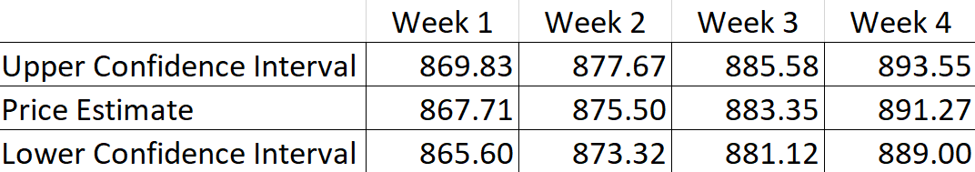
Bear Call Spreads
We can enter into a call spread, which simply is the simultaneous buying and selling of the same call option but at different strike prices
For example, we can sell Tesla call options four weeks out, in which we collect a premium but are obligated to sell the stock at the pre-specified price should the Tesla stock rise up to contract’s pre-specified strike price
More precisely, we can sell Tesla call options at $894 lower strike price because we are 95% confident that we are not going to be obligated to sell at the strike; in fact, the contracts will most likely expire worthless
But to hedge our risk*, we can buy the $899 higher strike such that our maximum loss is the difference between the strikes: 899 – 894 = $5 times the number of contract spreads we enter into
Of course, our max profit would be the premium collect from $894 strike less the purchase price of $899 strike times the number of contract spreads we wish to enter into
*In case 5% error rate occurs

Slide 29
Bull Put Spreads
At the same time we are receiving income from the call spread, we can be entering into the put spread
For example, we can sell Tesla put options four weeks out, in which we collect a premium but are obligated to buy at the pre-specified price should the Tesla stock fall down to contract’s pre-specified strike price
More precisely, we can sell Tesla put options at $888 higher strike price because we are 95% confident that we are not going to be obligated to buy at the strike; in fact, the contracts will most likely expire worthless
But to hedge our risk*, we can buy the $883 lower strike such that our maximum loss is the difference between the strikes: 888 – 883 = $5 times the number of spreads we enter into
Of course, our max profit would be the premium collect from $888 strike less the purchase price of $883 strike times the number of contract spreads we wish to enter into
*In case 5% error rate occurs

Slide 30
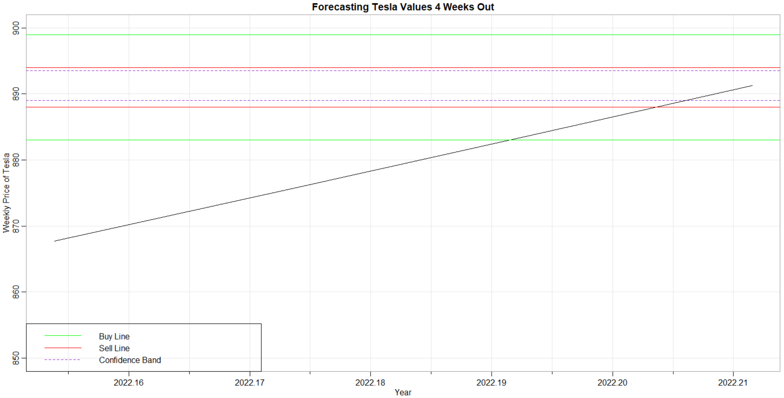

Slide 31
Strategy Assumptions
The model cannot take into account extraordinary movements in the Tesla stock, owing to a number of external factors like economic risks or internal risks like bankruptcy
Plus, the model is assuming a 5% error rate where the price will fall outside the 95% confidence bands at which point we can lose the max amount in the difference between the two strike prices
The 5% error rate produces a max lost (e.g., $5) much greater than the max profit (sale – purchase) of out-of-the-money options; so, there may be too much risk given the reward
And, our strategy made use of only the Confidence Intervals, not the more volatile Prediction Intervals in which any price point can find itself (i.e., the American option early exercise risk)
Although this strategy is naïve, it makes for some good preliminary thought on how to apply fruitfully the time series technique to trading and investment decisions

Slide 32
Thank you!
Any questions?

Slide 33
References
https://finance.yahoo.com/quote/TSLA/history?p=TSLA
Shumway, Robert. Time Series Analysis and Its Applications: With R Examples. Springer, 2017.

